Slide 1
Financial Education
A bank is a place that will lend you money if you can prove that you don't need it.
~Bob Hope

Slide 2
Credit Scores
Financial Education

Slide 3
AAA Fair Credit Foundation
Debt Management and Re-payment
Credit Counseling
Housing Counseling
Foreclosure Prevention
Budget Counseling
ID Theft and Fraud Counseling
Community Classes and Education
Matched Savings Accounts
www.faircredit.org

Slide 4
Modern Credit Reporting
Credit reporting was born more than 100 ago, when small retail merchants banded together to trade financial information about their customers. The merchant associations then turned into small credit bureaus, which later consolidated into larger ones with the advent of computerization.
By the 1960s, CRAs back then reported only negative financial information as well as "lifestyle" information culled from newspapers and other sources -- information such as social habits, arrests, drinking habits, and cleanliness.
The controversy led to a congressional inquiry, and in 1971, Congress passed the Fair Credit Reporting Act (FCRA), which established a framework for fair information practices to protect privacy and promote accuracy in credit reporting. Consumers gained the right to view, dispute and correct their records, and CRAs began to supplement the often-bleak reports with information on consumers' positive financial history.
www.faircredit.org

Slide 5
Info found on Credit Report
A Consumer Credit Report (CCR) details, in depth information about your credit history, and will also include:
Your full name
Any alias’s that you have used
Social Security Number
Current address
Previous addresses
www.faircredit.org
Notes:
It’s hard to imagine functioning in today’s society without access to credit. America’s average credit card debt is $9,000. Many individuals fall victim to some of the pitfalls associated with credit cards.
Teaser Rates - credit card companies will typically offer low introductory interest rates to attract new customers, but these rates typically last for only a few months and then jump as high as 20%.
Cash Rewards - Department stores always try and offer you their own credit cards. Some of these cards have deals like cash rewards after spending a certain amount or store discounts, but they typically have high interest rates, making the deals not worth it in the end.
So, how do you not fall victim to credit card pitfalls? You are here tonight to obtain financial education, which gives you power to make wise decisions.

Slide 6
(Cont’d)
Your credit report may also contain:
Your phone number
Age/date of birth
Your employer’s details
Your credit report does NOT contain:
Race
Color
Sex
National origin
Marital status
Political persuasion
Medical Bill Details (Lender Reports)
www.faircredit.org

Slide 7
What is a Credit Score? (FICO)
Snapshot of a person's financial standing at a particular point in time
The one most widely used is the "FICO" (Fair Isaac Corporation) score
The FICO score, a three-digit number between 300 and 850
www.faircredit.org
Notes:
Image: http://www.myfico.com/HelpCenter/FICOScores/

Slide 8
Credit Scoring Methodology (VantageScore)
VantageScore starts at 501 and runs to 990. The credit bureaus are now saying the VantageScore range is more "intuitive," because it breaks down like the familiar academic scale:
901-990 equals "A" credit 801-900 equals "B" credit 701-800 equals "C" credit 601-700 equals "D" credit 501-600 equals "F" credit

Slide 9
How have Scores Changed? (2009-2010)
The scoring model is the same
Credit Scores are falling, Why?
Delinquencies and debt loads
www.faircredit.org

Slide 10
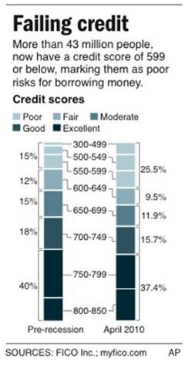
July 12, 2010 Pre and Post Recession Comparison
www.faircredit.org

Slide 11
Today’s Mortgage Rates:
30 Year Fixed (as of 7/16/2010)
Zion’s – 4.50%
AFCU – 4.625%
MACU – 4.50%
Wells Fargo – 4.625%
Chase – 4.875%
CitiMortgage – 4.75%
Bank of America – 4.875%
Closing and other costs not factored in (approx.)
www.faircredit.org

Slide 12
Who can qualify for that Rate…?
FICO
760-850
700-759
680-699
660-679
640-659
620-639
APR
4.297%
4.519%
4.696%
4.910%
5.340%
5.886%
Payment
$1,484
$1,523
$1,555
$1,594
$1,673
$1,777
As of 7/16/2010. Source: Informa Research Services
National Averages on a $300,000 Mortgage
No closing or point costs included, BASE RATE
Notes:
/Figures: http://www.myfico.com/HelpCenter/FICOScores/ >Accessed 7/17/2010

Slide 13
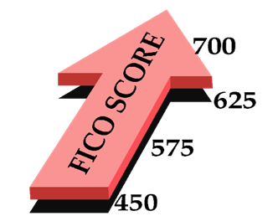
Mortgage Breaking Point
FICO of 720 or Higher =
Qualify for the Best Mortgage Rates
FICO of 620 or Higher =
May still qualify for FHA or other lending
Fico below 620 =
Not able to qualify at this time
NOTE: Lending also contingent upon other factors (Income, DTI)
www.faircredit.org
Notes:
Iamge from http://fortunewatch.com/wp-content/uploads/2007/11/fico_score.gif

Slide 14
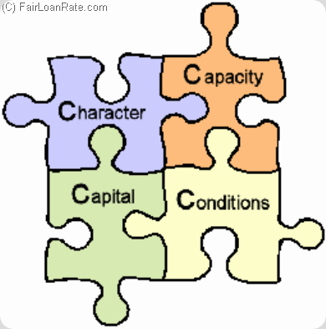
The 4 C’s
Character – History, Credit
Capacity – Cash Flow, Other Ratio’s
Capital – Ability to Absorb
Conditions – Collateral, Market, Loan
www.faircredit.org
Notes:
No, not diamonds…
Image: http://www.fairloanrate.com/wp-content/uploads/2009/04/4cs-of-credit.gif

Slide 15
Good Credit What does it really mean?
The loan payment will be lower → You qualify for a lower rate that yields a lower payment
The loan payment will be the same → You apply for a more expensive home, auto, etc.
www.faircredit.org

Slide 16
Why is Credit so Important?
Credit has become the new savings account
We no longer save, we rely on debt
We need to reduce the cost of debt as much as we can

Slide 17
Why do we use Credit so Frequently?
Marketing
Radio, TV, Internet, Billboards, E-mail, Newspaper, Inserted in programs
Entitlement
You Deserve…
You Have Earned…
You Need…
Great new “stuff” we can buy
Easy access to Credit
www.faircredit.org
Notes:
Image accessed at http://www.trackerboats.com/buy-now/buyNowBig.jpg

Slide 18
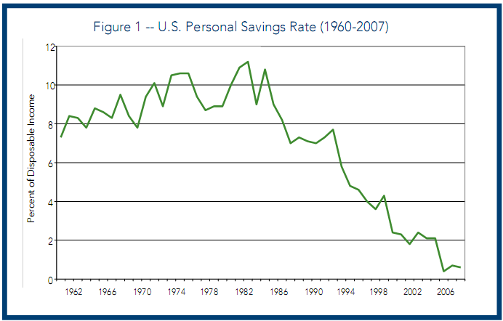
U.S. Personal Savings Rate
www.faircredit.org

Slide 19
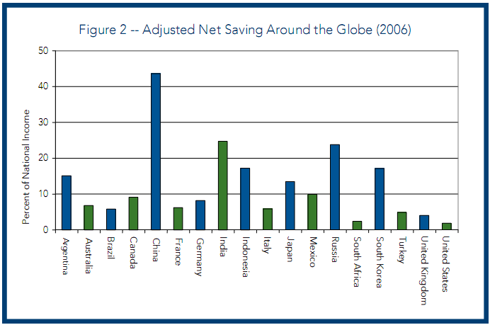
International Net Savings
www.faircredit.org

Slide 20
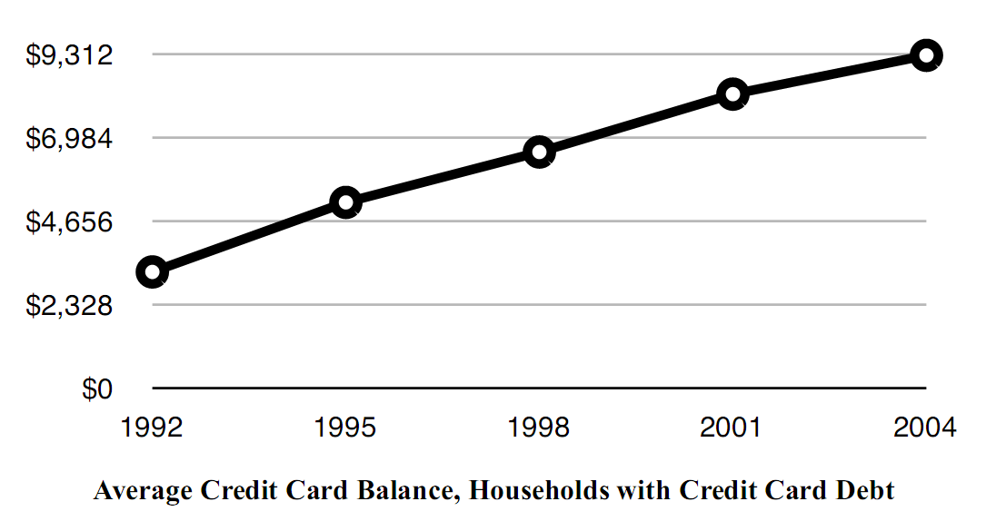
Avg Credit Card Balance

Slide 21
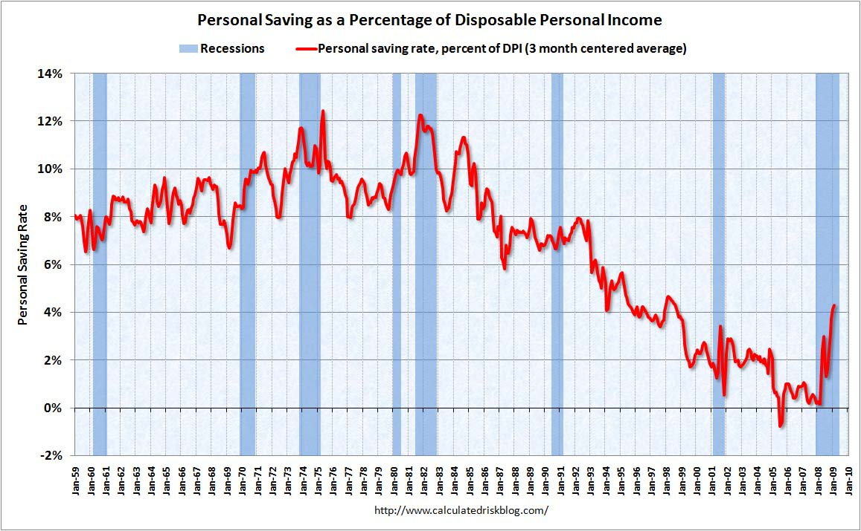
We are starting to SAVE again!
www.faircredit.org
Notes:
Link to Chart : http://www.calculatedriskblog.com/2009/03/february-pce-and-personal-saving-rate.html

Slide 22
U.S. National Debt Clock
The Outstanding Public Debt as of the 17th of July 2009 at 11:22 AM:
$13,201,632,345,897
Debt Per Citizen: $42,620
Debt Per Taxpayer: $119,339
www.faircredit.org
Notes:
Image: https://www.cia.gov/library/publications/the-world-factbook/flags/us-lgflag.gif
Numbers: www.usdebtclock.org

Slide 23
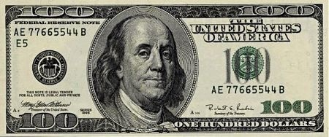
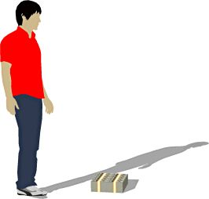
So How much is a Trillion?
$100
$10 k
$1 Million
$100 Million
www.faircredit.org

Slide 24
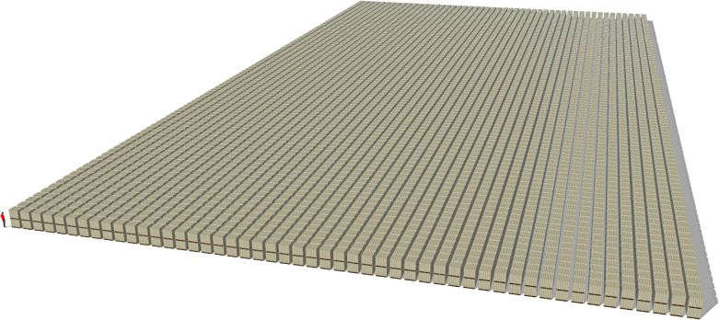
1 Trillion Dollars
The Economic Recession wasn’t the beginning of our debt problem

Slide 25
Good Debt vs. Bad Debt GOOD
A reasonable Mortgage Loan
A reasonable Auto Loan
Student Loans
Business Loans
Small Credit Load
These “GOOD” debts may be needed, but you can over-leverage yourself. In that case, it could be considered a bad debt.
www.faircredit.org

Slide 26
Good Debt vs. Bad Debt BAD
Excessive Credit Card Debt
Furniture Loans
Computer Loans
Retail Store Card Debt
Payday Loans
Tax Anticipation Loans
These “BAD” debts are a generalization. There may be times when you get a loan for something like a computer. REMEMBER, it is always better to save up money beforehand and pay cash.
www.faircredit.org

Slide 27
Who looks at your Credit?
Lenders
Credit Cards
Store Cards
Auto Loans
Mortgages
Personal Loans
Furniture Loans
Computer Loans
Utility Companies
Cell Phone Companies
Insurance Carrier
Employers
Military (Security Clearance)
Rental agents
Bank
(checking/savings accts)
www.faircredit.org

Slide 28
Which Accounts Build Credit?
YES
Credit Cards
Store Cards
Auto Loans
Mortgages
Personal Loans
Furniture Loans
Computer Loans
NO
Checking/Savings Accts
Cell Phone
Utilities
Insurance
Rental Agents (Housing)
Employers
Payday Loans
Title Loan Companies
www.faircredit.org

Slide 29
CARD Act 2010
Limits Rate Hikes
Limits Fees
No retroactive balance rate increase (exceptions)
Universal Default Protection
Opting Out of terms
Static Due Date
Consequence of min pmt
Payments must be applied to high rate balance
= They raised rates before the act went into effect
= This will cause rates for good credit individuals to increase universally in the future, incentives reduced
www.faircredit.org

Slide 30
How Does A Credit Score Help Me?
Improves risk assessment
Lenders, Insurance, Employers, Housing
More equitable treatment among borrowers
Able to qualify more quickly for credit
Credit “mistakes” will not affect your ability to obtain lending as drastically
www.faircredit.org

Slide 31
Where can you get your Report for Free?
(FACTA)
Internet
www.annualcreditreport.com
Mail
Annual Credit Report Request Service P.O. Box 105281 Atlanta, GA 30348-5281
Phone
1-877-322-8228
www.faircredit.org

Slide 32
Account Ownership
Individual
Authorized User
Co-Applicant
Joint Applicant
The account affects your credit the same whether you are an individual account holder, or a co-app.
Divorce proceedings do not change liability to pay debts, and will not remove items from your credit.
www.faircredit.org

Slide 33
Account Types
R = Revolving
Credit Cards
Home Equity Lines
Overdraft Protection
I = Installment
Mortgage
Auto Loan
Personal Loan
Student Loan
Collections/Charge Off
Public Records
www.faircredit.org

Slide 34
Review of Reports
Experian – Consumer
Equifax – Consumer
Trans Union
Equifax - Lender
www.faircredit.org

Slide 35
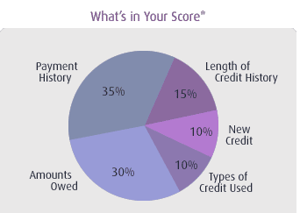
How the FICO Score is Calculated
www.faircredit.org

Slide 36
Payment History
Pay your bills on time.
If you have missed payments, get current and stay current.
Late payments HURT your credit
How do you know when it is time to pay your bill?
www.faircredit.org

Slide 37
Amounts Owed
Keep balances low on credit cards and other “revolving credit”
50 / 75 / 100% Utilization Ratio’s
Pay down debt (Not Just the Min Pmt)
Try to stay below 30% Utilization
www.faircredit.org

Slide 38
Length of Credit History
Rapid account buildup can look risky if you are a new credit user.
Don’t apply for credit just to get a store discount!
Don't close unused credit cards as a short-term strategy to raise your score.
Maintain accounts long term
www.faircredit.org

Slide 39
Types of Credit Used
Apply for and open new credit accounts only as needed.
Don’t use unnecessary credit just to try and build your score.
Use and manage credit cards responsibly. In general, having credit cards and installment loans (and paying timely payments) will raise your score.
Note that closing an account doesn't make it go away. A closed account will still show up on your credit report, and may be considered by the score.
Credit Union Accounts vs. National Bank accounts
www.faircredit.org

Slide 40
New Credit
Evaluation of the new credit in use
Avoid too many credit inquiries
Every time a lender looks at your credit report it hurts your score
Window for Auto/Mortgage
AVOID opening new accounts all the time to have new credit.
www.faircredit.org

Slide 41
Collection Process
0 to 60 days past due
Notice of Late payment Letters are sent
Customer telephoned for immediate arrangement
Typically one day is allowed after leaving message for customer before follow-up phone call.
Initial derogatory report made to credit bureaus at day 31 of delinquency
Rate increased for default, late fee’s added to balance
60-120 days past due
Advanced delinquency procedures begin:
• Account closed or credit line suspended;
ongoing derogatory reporting to credit bureau
• Phone calls and letters continue, may increase
• Notice of default sent to customer.
Even if acct is brought current, creditor may refuse to re-open the LOC
Over 120 days past due
• Ongoing derogatory reporting; balance is
accelerated and payable in full.
• Third-party collectors often take over the account
from the creditor.
Phone calls from two parties, letters with a more threatening tone.
• Legal proceedings are initiated for judgments;
repossession; execution; garnishment, etc.

Slide 42
On the Positive Side…
Having Good Credit =
Auto Loan qualification in less than 10 minutes
CC qualification online in seconds
Home Loan Pre-qualification in Minutes, Processing in less than 30 days
Great rates on lending products
www.faircredit.org

Slide 43
Credit in the Classroom

Slide 44
Credit Score
Homework for a class = Payment on an account
Good Grade = Positive Account
This leads to:
High GPA = High Credit Score
This leads to:
Qualify for College = Qualify for Loan
www.faircredit.org

Slide 45
Pop Quiz
Needing credit can be like a pop quiz
You don’t always know when it will happen…(need new auto after accident)
Think about what your grades look like right now, how are you doing?
The same is applicable to credit
www.faircredit.org

Slide 46
Credit Worthiness
Which friends are they likely/not likely to lend money to? Why?
What would you say if another person asked you if it were safe to lend to your friend?
What if someone you didn’t know wanted to borrow from you?
This shows why credit scoring is important today-non biased number
www.faircredit.org

Slide 47
Credit Score Estimator
MyFico.com (credit score estimate)
Create multiple scenarios
Name, # of Accts, Payment History, etc.
Have students research scenarios
Class - guess the estimated score
Preferential treatment to high scores
Fewer quiz questions to students with higher grades
www.faircredit.org

Slide 48
Self Evaluation
Is the Student responsible for any payments (How often are they paid on time/late?)
Do they know the difference between Debit / Credit cards?
Do they know how interest works (use amortization schedules)
Know how to create/follow a budget
Do they balance bank accounts?
www.faircredit.org

Slide 49
Self Evaluation (cont.)
How well do they manage cell phone plans?
Do they go over their minutes/texts?
This could be an indicator of how they would use credit
NOTE: If they have unlimited texts, know that there isn’t unlimited credit
Could they restrict themselves, → Try
www.faircredit.org

Slide 50
The Cost of Credit - TV
Television: Regularly $900, on Sale for $850
Savings- the cost is $850 ($900 if no longer on sale)
Credit Card – at 21% interest over 12 months the cost is $79 per month or $950
Rent to Own – at 100% interest over 12 months the cost is $114 per month or $1377
www.faircredit.org

Slide 51
Cost of Credit - Auto
Good Credit History
Pay $15000
Loan Terms 60 months at 4.5%
Payment = $297 a month
Total Cost of payments
= ($279.65)x(60 months) = $16,779
Poor Credit History
Pay $15000
Loan Terms 60 months at 26%
Payment = $372 a month
Total Cost of payments
= ($449.11)x(60 months) = $26,946
www.faircredit.org

Slide 52
Cost of Credit - Mortgage
750 + FICO
Pay $200,000, 30 Yr Fixed at 4.5%
Total Cost of payments
= ($1013.37)x(360 months) = $364,680
620 FICO
Same loan at 6%,
Total Cost of payments
= ($1199.10)x(360 months) = $431,676
DIFFERENCE = $66,996
www.faircredit.org

Slide 53
SNL
Credit vs. Savings
www.faircredit.org

Slide 54
A good Reason to Check your Credit Annually
www.faircredit.org

Slide 55
Fast Track Credit Improvement
Review your Credit Report
Provided by Ivory
Dispute Errors with all 3 Bureau’s
Budgeting is VITAL
Eliminate all frivolous expenses
Sacrifice now for the later benefit
Pay Down Debt
Pay off collection accounts
Reduce debt on LOC’s (below 30%)
Ask Creditors to report to all three bureaus
DO NOT OPEN OR CLOSE ACCOUNTS DURING THIS PROCESS
www.faircredit.org

Slide 56
Fast Track Credit Improvement (cont.)
Request Payoff notices from Creditors
Send a copy of the payoff notice to all credit bureaus and ask them to update your report
Pull Credit again Wait for a couple of weeks after payoff notices are sent
Check AnnualCR to make sure updates are made
www.faircredit.org
Notes:
Image: http://www.trackpracticeplans.com/trackshoes-small.jpg

Slide 57
Sample Dispute Letter
Date
Your name
Your address
Your city, state, Zip code
Complaint Department
Name of credit Reporting agency
Address
City, state, Zip code
Dear Sir or Madam:
I am writing to dispute the following information in my file. The items I dispute are also encircled on the attached copy of the report I received. (Identify item(s) disputed by name of source, such as creditors or tax court, and identify type of item, such as credit account, judgment, etc.) This item is (inaccurate or incomplete) because (describe what is inaccurate or incomplete and why). I am requesting that the item be deleted (or request another specific change) to correct the information. Enclosed are copies of (use this sentence if applicable and describe any enclosed documentation, such as payment records, court documents) supporting my position. please reinvestigate this (these) matter(s) and (delete or correct) the disputed item(s) as soon as possible.
Sincerely,
Your name
enclosures: (list what you are enclosing)

Slide 58
Is Longer Term Improvement Needed?
Meet with a Credit Counselor
Develop and follow a Spending Plan
(This is code for Budget)
Determine a priority list for paying debts
Find the most effective method to reduce debt loads
Open and build new Credit as necessary
(This doesn’t mean we create debt)
www.faircredit.org

Slide 59
LIFESTYLE GUIDLINES
Don’t use Credit for Everything, learn to save!
When using credit, plan so you can pay accounts off in full at the end of the month.
Control your Spending Habits
www.faircredit.org

Slide 60
How do I build Credit if I have never had it?
Open a line of Credit: Credit Card
Buy things you would normally buy, pay off at the end of each month
If you don’t qualify, consider a secured card
Take caution when asking for a co-signer
Buy things you would normally buy during the month
Pay the account off in full at the end of each month
www.faircredit.org

Slide 61
Free Financial Counseling
Will VanderToolen
Director of Counseling and Education
AAA Fair Credit Foundation
230 West 200 South, Suite 3104
Salt Lake City, UT 84101
Certified Credit and Debt Counselors
HUD Approved Housing Counselors
800-351-4195
www.faircredit.org

Slide 62
asdf
asdf
www.faircredit.org

